Slide 1
Module 5.2
Concurrency Control,
Lock-based Protocols and Deadlocks, Database Recovery

Slide 2
Objective:
Understanding Concurrency control schemes and implementing serializability with locks and timestamps; Deadlocks with suitable examples

Slide 3
Contents:
Concurrency control and Implementing Serializability
Lock-based protocols and Deadlocks
Timestamp based protocols
Introduction to Database recovery and Log-based recovery
Checkpointing
Shadow paging

Slide 4
Purpose of Concurrency Control
To enforce Isolation (through mutual exclusion) among conflicting transactions.
To preserve database consistency through consistency preserving execution of transactions.
To resolve read-write and write-write conflicts.
Example:
In concurrent execution environment if T1 conflicts with T2 over a data item A, then the existing concurrency control decides if T1 or T2 should get the A and if the other transaction is rolled-back or waits.

Slide 5
Binary Locks
A binary lock has two states zero or one (0 or 1)
L(X) = 1 means the database object X is locked
L(X) = 0 means the database object X is unlocked
Statements:
Lock(X) – Lock on object X
UnLock(X) – Unlock on object X

Slide 6
Binary Lock Algorithms
Algorithm Lock(X)
{
Repeat
{
if L(X) = 0
then L(X) =1.
} until L(X) = 0.
Wake up T.
}
Algorithm UnLock(X)
{
L(X) = 0;
if any T is waiting in queue
then Wake up T.
}

Slide 7
Shared and Exclusive Locks
Shared lock S(A): If a shared lock is requested by T, the lock manager grants it provided there is no exclusive lock on the object A,
i.e. L(A) = 'S'. Lock manager increments the count of number of read locks on X by one.
Exclusive lock X(A): If an exclusive lock is requested by T, the lock manager grants it provided no other transaction holds a lock on X i.e. L(A) = 'X'.
If the request raised by T can not be granted, then it is inserted into the queue and T is suspended.

Slide 8
Two-Phase Locking Techniques
Locking is an operation which secures
(a) permission to Read
(b) permission to Write a data item for a transaction.
Example:
Lock (X). Data item X is locked in behalf of the requesting transaction.
Unlocking is an operation which removes these permissions from the data item.
Example:
Unlock (X): Data item X is made available to all other transactions.
Lock and Unlock are Atomic operations.

Slide 9
Two-Phase Locking Techniques: Essential components
Two locks modes:
(a) shared (read) (b) exclusive (write).
Shared mode: shared lock (X)
More than one transaction can apply share lock on X for reading its value but no write lock can be applied on X by any other transaction.
Exclusive mode: Write lock (X)
Only one write lock on X can exist at any time and no shared lock can be applied by any other transaction on X.
Conflict matrix

Slide 10
Two-Phase Locking Techniques: Essential components
Lock Manager:
Managing locks on data items.
Lock table:
Lock manager uses it to store the identify of transaction locking a data item, the data item, lock mode and pointer to the next data item locked. One simple way to implement a lock table is through linked list.

Slide 11
Two-Phase Locking Techniques: Essential components
Database requires that all transactions should be well-formed. A transaction is well-formed if:
It must lock the data item before it reads or writes to it.
It must not lock an already locked data items and it must not try to unlock a free data item.

Slide 12
Two-Phase Locking Techniques: Essential components
The following code performs the lock operation:
B: if LOCK (X) = 0 (*item is unlocked*)
then LOCK (X) ← 1 (*lock the item*)
else begin
wait (until lock (X) = 0) and
the lock manager wakes up the transaction);
goto B
end;

Slide 13
Two-Phase Locking Techniques: Essential components
The following code performs the unlock operation:
LOCK (X) ← 0 (*unlock the item*)
if any transactions are waiting then
wake up one of the waiting the transactions;

Slide 14
Two-Phase Locking Techniques: Essential components
The following code performs the read operation:
B: if LOCK (X) = “unlocked” then
begin LOCK (X) ← “read-locked”;
no_of_reads (X) ← 1;
end
else if LOCK (X) ← “read-locked” then
no_of_reads (X) ← no_of_reads (X) +1
else begin wait (until LOCK (X) = “unlocked” and
the lock manager wakes up the transaction);
go to B
end;

Slide 15
Two-Phase Locking Techniques: Essential components
The following code performs the write lock operation:
B: if LOCK (X) = “unlocked” then
begin LOCK (X) ← “read-locked”;
no_of_reads (X) ← 1;
end
else if LOCK (X) ← “read-locked” then
no_of_reads (X) ← no_of_reads (X) +1
else begin wait (until LOCK (X) = “unlocked” and
the lock manager wakes up the transaction);
go to B
end;

Slide 16
Two-Phase Locking Techniques: Essential components
The following code performs the unlock operation:
if LOCK (X) = “write-locked” then
begin LOCK (X) ← “unlocked”;
wakes up one of the transactions, if any
end
else if LOCK (X) ← “read-locked” then
begin
no_of_reads (X) ← no_of_reads (X) -1
if no_of_reads (X) = 0 then
begin
LOCK (X) = “unlocked”;
wake up one of the transactions, if any
end
end;

Slide 17
Two-Phase Locking Techniques: Essential components
Lock conversion
Lock upgrade: existing read lock to write lock
if Ti has a read-lock (X) and Tj has no read-lock (X) (i ≠ j) then
convert read-lock (X) to write-lock (X)
else
force Ti to wait until Tj unlocks X
Lock downgrade: existing write lock to read lock
Ti has a write-lock (X) (*no transaction can have any lock on X*)
convert write-lock (X) to read-lock (X)

Slide 18
Two-Phase Locking Techniques: The algorithm
Two Phases:
(a) Locking (Growing)
(b) Unlocking (Shrinking).
Locking (Growing) Phase:
A transaction applies locks (read or write) on desired data items one at a time.
Unlocking (Shrinking) Phase:
A transaction unlocks its locked data items one at a time.
Requirement:
For a transaction these two phases must be mutually exclusively, that is, during locking phase unlocking phase must not start and during unlocking phase locking phase must not begin.

Slide 19
Two-Phase Locking Techniques: The algorithm
T1 T2 Result
read_lock (Y); read_lock (X); Initial values: X=20; Y=30
read_item (Y); read_item (X); Result of serial execution
unlock (Y); unlock (X); T1 followed by T2
write_lock (X); Write_lock (Y); X=50, Y=80.
read_item (X); read_item (Y); Result of serial execution
X:=X+Y; Y:=X+Y; T2 followed by T1
write_item (X); write_item (Y); X=70, Y=50
unlock (X); unlock (Y);

Slide 20
Two-Phase Locking Techniques: The algorithm
T1 T2 Result
read_lock (Y); X=50; Y=50
read_item (Y); Nonserializable because it.
unlock (Y); violated two-phase policy.
read_lock (X);
read_item (X);
unlock (X);
write_lock (Y);
read_item (Y);
Y:=X+Y;
write_item (Y);
unlock (Y);
write_lock (X);
read_item (X);
X:=X+Y;
write_item (X);
unlock (X);
Time

Slide 21
Two-Phase Locking Techniques: The algorithm
T’1 T’2
read_lock (Y); read_lock (X); T1 and T2 follow two-phase
read_item (Y); read_item (X); policy but they are subject to
write_lock (X); Write_lock (Y); deadlock, which must be
unlock (Y); unlock (X); dealt with.
read_item (X); read_item (Y);
X:=X+Y; Y:=X+Y;
write_item (X); write_item (Y);
unlock (X); unlock (Y);

Slide 22
Two-Phase Locking Techniques: The algorithm
Two-phase policy generates two locking algorithms
(a) Basic
(b) Conservative
Conservative:
Prevents deadlock by locking all desired data items before transaction begins execution.
Basic:
Transaction locks data items incrementally. This may cause deadlock which is dealt with.
Strict:
A more stricter version of Basic algorithm where unlocking is performed after a transaction terminates (commits or aborts and rolled-back). This is the most commonly used two-phase locking algorithm.

Slide 23
Dealing with Deadlock and Starvation
Deadlock
T’1 T’2
read_lock (Y); T1 and T2 did follow two-phase
read_item (Y); policy but they are deadlock
read_lock (X);
read_item (Y);
write_lock (X);
(waits for X) write_lock (Y);
(waits for Y)
Deadlock (T’1 and T’2)

Slide 24
Dealing with Deadlock and Starvation
Deadlock-Example 2
T1 T2
X(A)
W(A)
X(B)
W(B)
X(A)
W(A)
X(B)
W(B)

Slide 25
Deadlock Prevention
Priority to each transaction is assigned.
Ts are allowed to wait depending upon their priorities
Assigning the priority means associating a unique value, called timestamp, to each transaction
Lower timestamp - higher priority
Higher timestamp - lower priority

Slide 26
Methods
Wait-die:
(a) If Ti < Tj (Ti has a higher priority than Tj), then Ti is allowed to wait. Otherwise, Ti is aborted and rolled back.
(b) Lower priority transactions can never wait for higher priority transactions.
(c) It is nonpreemptive meaning only a transaction
requesting a lock can be aborted.
Wound-wait:
(a) If Ti < Tj (Ti has a higher priority than Tj), then abort Tj. Otherwise, Ti is allowed to wait.
(b) Higher priority transactions can never wait for lower priority transactions. Or, higher priority ones wounds (forces rollback) of lower priority ones.
(c) It is preemptive.

Slide 27
Wait-die
Wound-wait
T2 holds a lock
T1 holds a lock
A
A
T1 requests a lock
T2 requests a lock
T1 can wait
T2 is aborted
T2 holds a lock
T1 holds a lock
A
A
T1 requests a lock
T2 requests a lock
Abort T2
T2 can wait

Slide 28
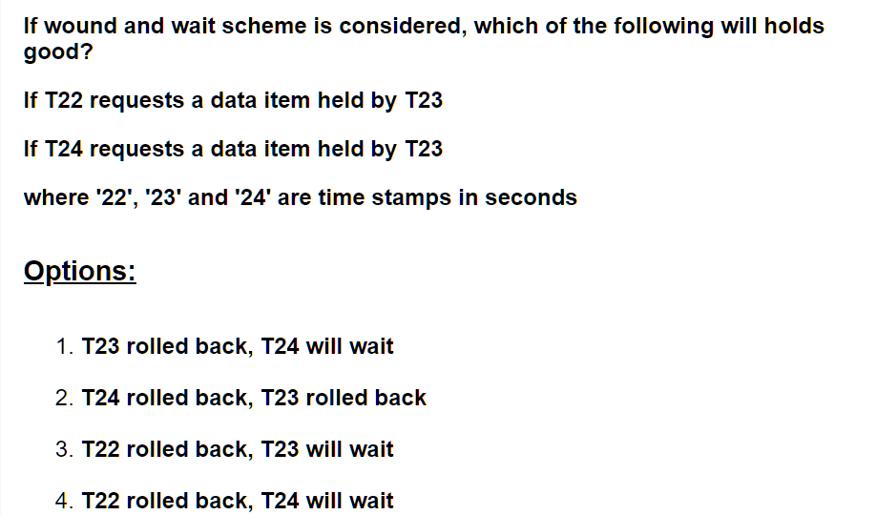
Wound-wait

Slide 29
Deadlock Detection
To detect deadlocks we use a waits-for graph.
Step-1: Draw a vertex for each transaction in the schedule
Step-2: An edge Ti → Tj is added to the graph if and only if Ti is waiting for Tj
Step-3: An edge Ti → Tj is removed from the graph if Tj has released the lock
Step-4: If the graph at any point of time has cycles, it implies a deadlock

Slide 30
Example-1
T1 T2 T3 T4
X(A)
X(A)
X(A)
X(B)
X(B)
T1
T2
T3
T4

Slide 31
Example 2
T1 T2
X(A)
W(A)
X(B)
W(B)
X(A)
W(A)
X(B)
W(B)
T1
T2

Slide 32
Dealing with Deadlock and Starvation
Starvation
Starvation occurs when a particular transaction consistently waits or restarted and never gets a chance to proceed further.
In a deadlock resolution it is possible that the same transaction may consistently be selected as victim and rolled-back.
This limitation is inherent in all priority based scheduling mechanisms.
In Wound-Wait scheme a younger transaction may always be wounded (aborted) by a long running older transaction which may create starvation.

Slide 33
Timestamp based concurrency control algorithm
Timestamp
A monotonically increasing variable (integer) indicating the age of an operation or a transaction. A larger timestamp value indicates a more recent event or operation.
Timestamp based algorithm uses timestamp to serialize the execution of concurrent transactions.

Slide 34
Timestamp based concurrency control algorithm
Basic Timestamp Ordering
1. Transaction T issues a write_item(X) operation:
If read_TS(X) > TS(T) or if write_TS(X) > TS(T), then an younger transaction has already read the data item so abort and roll-back T and reject the operation.
If the condition in part (a) does not exist, then execute write_item(X) of T and set write_TS(X) to TS(T).
2. Transaction T issues a read_item(X) operation:
If write_TS(X) > TS(T), then an younger transaction has already written to the data item so abort and roll-back T and reject the operation.
If write_TS(X) ≤ TS(T), then execute read_item(X) of T and set read_TS(X) to the larger of TS(T) and the current read_TS(X).

Slide 35
Timestamp based concurrency control algorithm
Strict Timestamp Ordering
1. Transaction T issues a write_item(X) operation:
If TS(T) > read_TS(X), then delay T until the transaction T’ that wrote or read X has terminated (committed or aborted).
2. Transaction T issues a read_item(X) operation:
If TS(T) > write_TS(X), then delay T until the transaction T’ that wrote or read X has terminated (committed or aborted).

Slide 36
Timestamp based concurrency control algorithm
Thomas’s Write Rule
If read_TS(X) > TS(T) then abort and roll-back T and reject the operation.
If write_TS(X) > TS(T), then just ignore the write operation and continue execution. This is because the most recent writes counts in case of two consecutive writes.
If the conditions given in 1 and 2 above do not occur, then execute write_item(X) of T and set write_TS(X) to TS(T).

Slide 37
Databases Recovery

Slide 38
Purpose of Database Recovery
To bring the database into the last consistent state, which existed prior to the failure.
To preserve transaction properties (Atomicity, Consistency, Isolation and Durability).
Example:
If the system crashes before a fund transfer transaction completes its execution, then either one or both accounts may have incorrect value. Thus, the database must be restored to the state before the transaction modified any of the accounts.

Slide 39
Types of Failure
The database may become unavailable for use due to
Transaction failure: Transactions may fail because of incorrect input, deadlock, incorrect synchronization.
System failure: System may fail because of addressing error, application error, operating system fault, RAM failure, etc.
Media failure: Disk head crash, power disruption, etc.

Slide 40
Transaction Log
For recovery from any type of failure data values prior to modification (BFIM - BeFore Image) and the new value after modification (AFIM – AFter Image) are required.
These values and other information is stored in a sequential file called Transaction log. A sample log is given below. Back P and Next P point to the previous and next log records of the same transaction.

Slide 41
Data Update
Immediate Update: As soon as a data item is modified in cache, the disk copy is updated.
Deferred Update: All modified data items in the cache is written either after a transaction ends its execution or after a fixed number of transactions have completed their execution.
Shadow update: The modified version of a data item does not overwrite its disk copy but is written at a separate disk location.
In-place update: The disk version of the data item is overwritten by the cache version.

Slide 42
Data Caching
Data items to be modified are first stored into database cache by the Cache Manager (CM) and after modification they are flushed (written) to the disk.
The flushing is controlled by Modified and Pin-Unpin bits.
Pin-Unpin: Instructs the operating system not to flush the data item.
Modified: Indicates the AFIM of the data item.

Slide 43
Transaction Roll-back (Undo) and Roll-Forward (Redo)
To maintain atomicity, a transaction’s operations are redone or undone.
Undo: Restore all BFIMs on to disk (Remove all AFIMs).
Redo: Restore all AFIMs on to disk.
Database recovery is achieved either by performing only Undos or only Redos or by a combination of the two. These operations are recorded in the log as they happen.

Slide 44
Recovery Methods
Undo (Backup Recovery)
Redo (Forward Recovery)
Database
With changes
Undo
Database
Without changes
Before
Image
Database
Without
changes
Redo
Database
With changes
After
Image

Slide 45
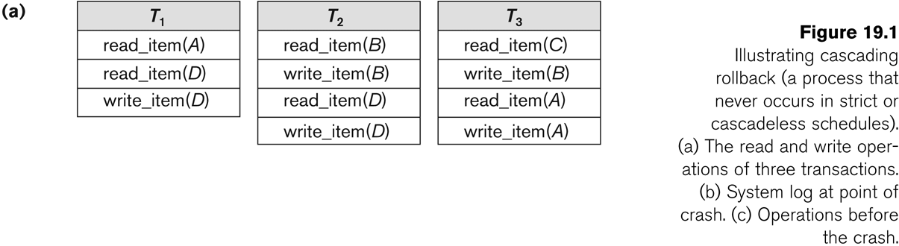

Slide 46
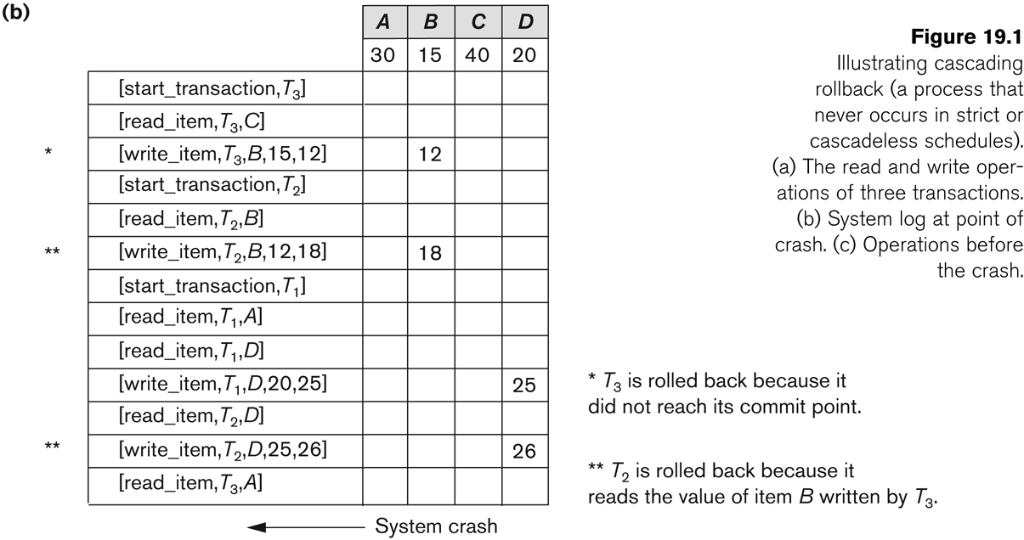

Slide 47
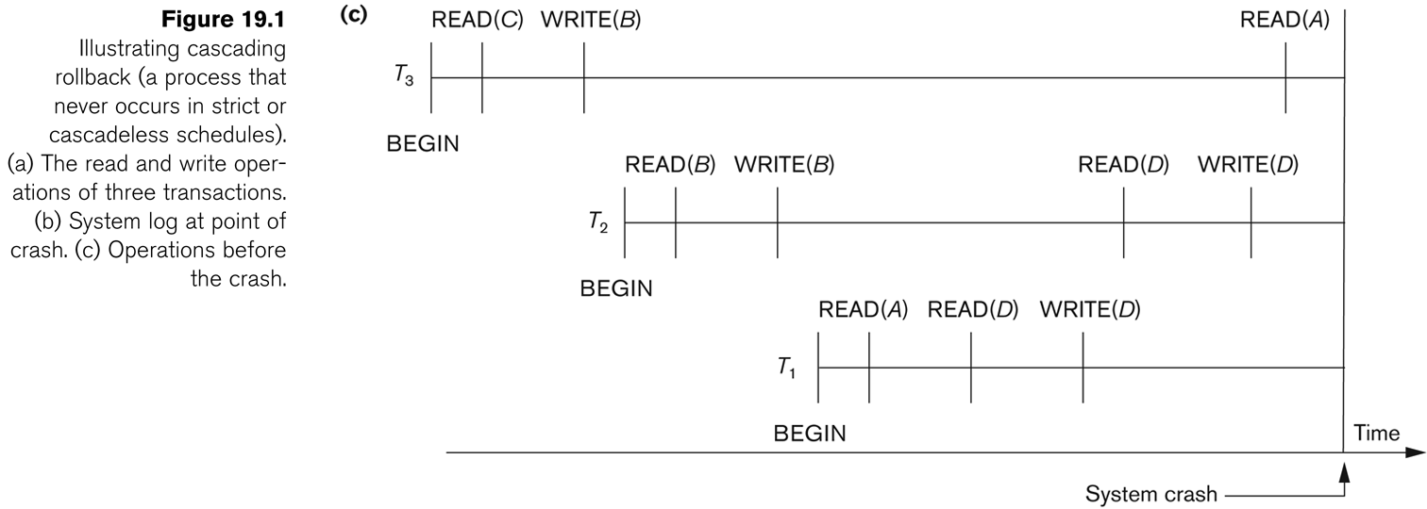
Roll-back: One execution of T1, T2 and T3 as recorded in the log.

Slide 48
Write-Ahead Logging
When in-place update (immediate or deferred) is used then log is necessary for recovery and it must be available to recovery manager. This is achieved by Write-Ahead Logging (WAL) protocol. WAL states that
For Undo: Before a data item’s AFIM is flushed to the database disk (overwriting the BFIM) its BFIM must be written to the log and the log must be saved on a stable store (log disk).
For Redo: Before a transaction executes its commit operation, all its AFIMs must be written to the log and the log must be saved on a stable store.

Slide 49
Checkpointing
Time to time (randomly or under some criteria) the database flushes its buffer to database disk to minimize the task of recovery. The following steps defines a checkpoint operation:
Suspend execution of transactions temporarily.
Force write modified buffer data to disk.
Write a [checkpoint] record to the log, save the log to disk.
Resume normal transaction execution.
During recovery redo or undo is required to transactions appearing after [checkpoint] record.

Slide 50
Steal/No-Steal and Force/No-Force
Possible ways for flushing database cache to database disk:
Steal: Cache can be flushed before transaction commits.
No-Steal: Cache cannot be flushed before transaction commit.
Force: Cache is immediately flushed (forced) to disk.
No-Force: Cache is deferred until transaction commits
These give rise to four different ways for handling recovery:
Steal/No-Force (Undo/Redo)
Steal/Force (Undo/No-redo)
No-Steal/No-Force (Redo/No-undo)
No-Steal/Force (No-undo/No-redo)

Slide 51
Recovery Scheme
Deferred Update (No Undo/Redo)
The data update goes as follows:
A set of transactions records their updates in the log.
At commit point under WAL scheme these updates are saved on database disk.
After reboot from a failure the log is used to redo all the transactions affected by this failure. No undo is required because no AFIM is flushed to the disk before a transaction commits.

Slide 52
Deferred Update in a single-user system There is no concurrent data sharing in a single user system. The data update goes as follows:
A set of transactions records their updates in the log.
At commit point under WAL scheme these updates are saved on database disk.
After reboot from a failure the log is used to redo all the transactions affected by this failure. No undo is required because no AFIM is flushed to the disk before a transaction commits.

Slide 53
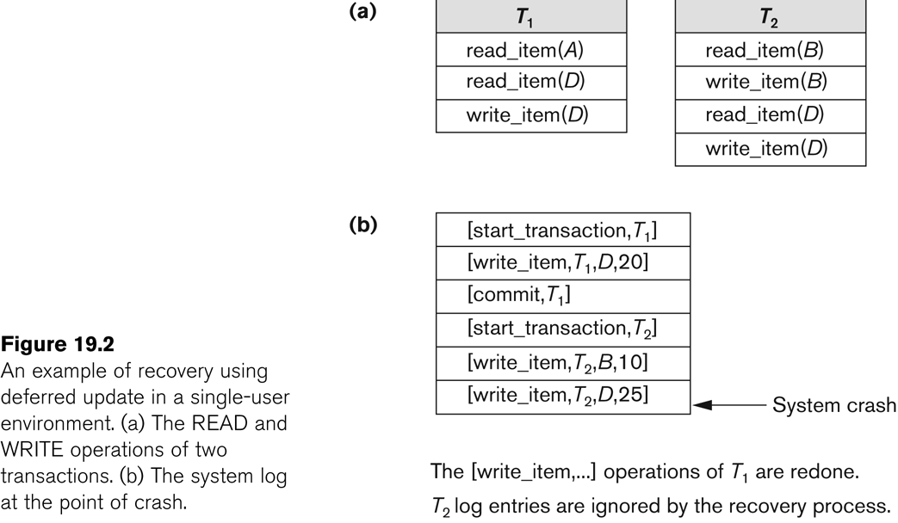

Slide 54
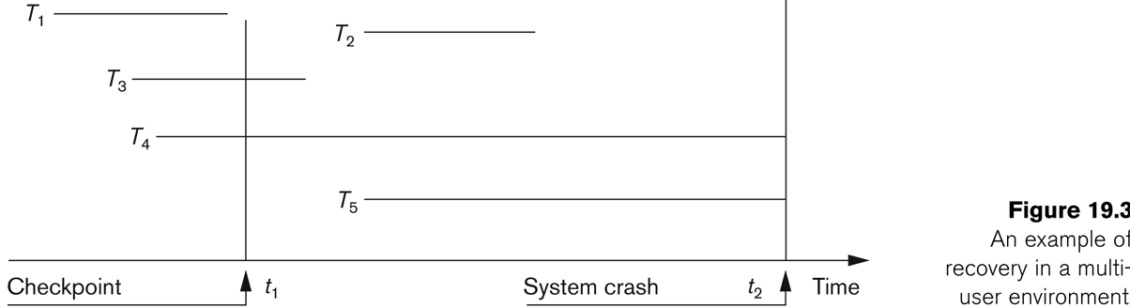
Deferred Update with concurrent users
This environment requires some concurrency control mechanism to guarantee isolation property of transactions. In a system recovery transactions which were recorded in the log after the last checkpoint were redone. The recovery manager may scan some of the transactions recorded before the checkpoint to get the AFIMs.

Slide 55
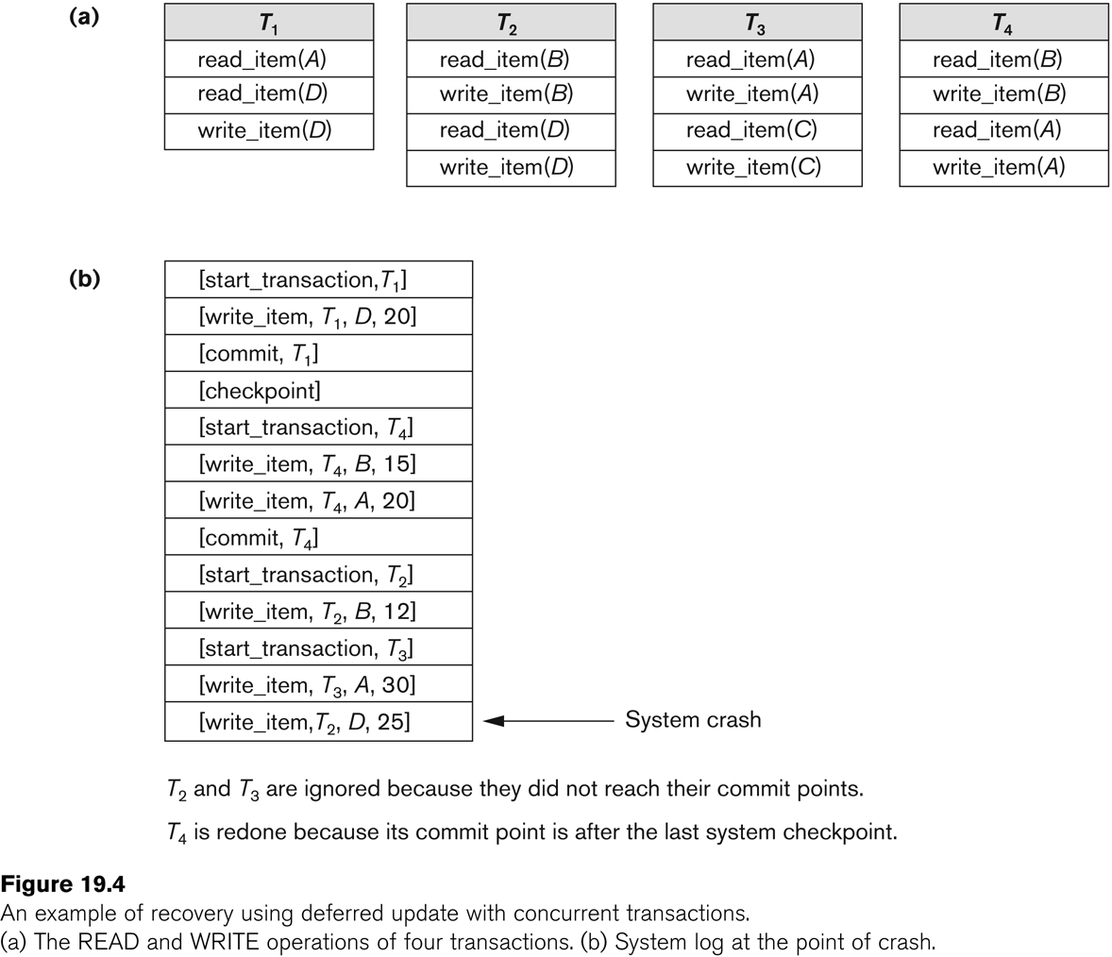

Slide 56
Deferred Update with concurrent users
Two tables are required for implementing this protocol:
Active table: All active transactions are entered in this table.
Commit table: Transactions to be committed are entered in this table.
During recovery, all transactions of the commit table are redone and all transactions of active tables are ignored since none of their AFIMs reached the database. It is possible that a commit table transaction may be redone twice but this does not create any inconsistency because of a redone is “idempotent”, that is, one redone for an AFIM is equivalent to multiple redone for the same AFIM.

Slide 57
Recovery Techniques Based on Immediate Update
Undo/No-redo Algorithm
In this algorithm AFIMs of a transaction are flushed to the database disk under WAL before it commits.
For this reason the recovery manager undoes all transactions during recovery.
No transaction is redone.
It is possible that a transaction might have completed execution and ready to commit but this transaction is also undone.

Slide 58
Recovery Techniques Based on Immediate Update
Undo/Redo Algorithm (Single-user environment)
Recovery schemes of this category apply undo and also redo for recovery.
In a single-user environment no concurrency control is required but a log is maintained under WAL.
Note that at any time there will be one transaction in the system and it will be either in the commit table or in the active table.
The recovery manager performs:
Undo of a transaction if it is in the active table.
Redo of a transaction if it is in the commit table.

Slide 59
Recovery Techniques Based on Immediate Update
Undo/Redo Algorithm (Concurrent execution)
Recovery schemes of this category applies undo and also redo to recover the database from failure.
In concurrent execution environment a concurrency control is required and log is maintained under WAL.
Commit table records transactions to be committed and active table records active transactions. To minimize the work of the recovery manager checkpointing is used.
The recovery performs:
Undo of a transaction if it is in the active table.
Redo of a transaction if it is in the commit table.

Slide 60
Shadow Paging
The AFIM does not overwrite its BFIM but recorded at another place on the disk. Thus, at any time a data item has AFIM and BFIM (Shadow copy of the data item) at two different places on the disk.
X and Y: Shadow copies of data items
X' and Y': Current copies of data items

Slide 61
No-Undo/No-Redo Protocol (Shadow Paging)
Page 4
(old)
Page 1
Page 3
Page 2
(new)
Page 4
(new)
Page 2
(old)
1 •
2 •
3 •
4 •
5 •
Current directory
(updating pages 2 & 4)
• 1
• 2
• 3
• 4
• 5
Shadow directory

Slide 62
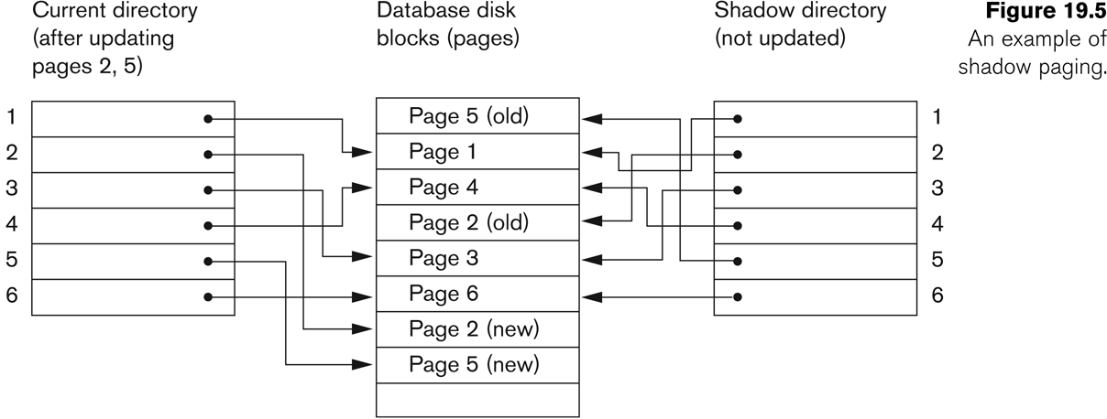
Shadow Paging
To manage access of data items by concurrent transactions two directories (current and shadow) are used.
The directory arrangement is illustrated below. Here a page is a data item.

